Slide 1
World Wide Sports
By Eric Maslyanchuk, Jake Gentry, Jorge Ortiz, Isaac Billow

Slide 2
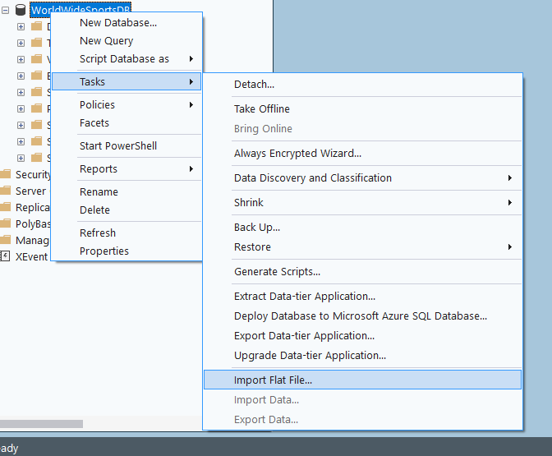
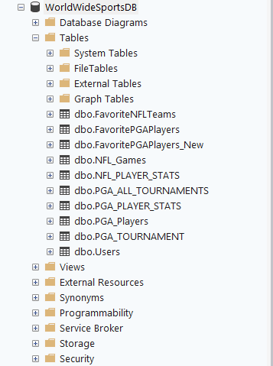
Sports Data Collection and Integration
Collected PGA and NFL datasets from outside sources.
Raw CSV data was cleaned and prepared to be imported into a SQL Server table structure.
Loaded data into SSMS by import flat file.

Slide 3
User Authentication
Create a completely functional user authentication systems with SQL Servers, TableAdapters, and Window Forms.
Login form that uses a query called CheckLogin to verify login credentials.
Form called Create Account that lets users create new accounts.
CheckUsername is a count query that prevents duplicate usernames.
CreateUser is a secure database insert action that uses an insert query
Strong password standards are used, data integrity is guaranteed, and duplicate users are prevented.

Slide 4
